Slide 1
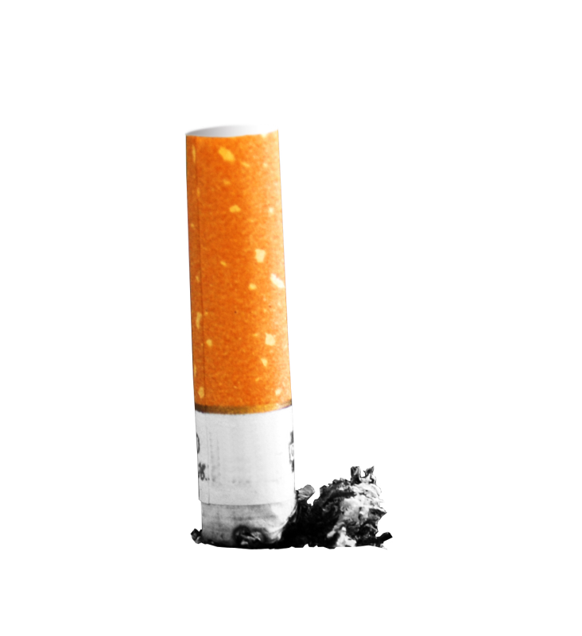
TOBACCO
Don’t be a Butthead

Slide 2
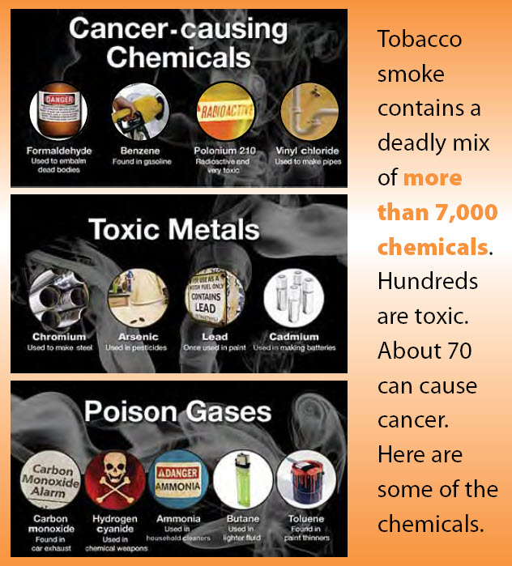
Tobacco
Contains NICOTINE -- the addictive drug in tobacco; triggers the release of stress hormones.
Nicotine is classified as a Stimulant -- a drug that increases the action of the CNS, the heart, and other organs.
Tobacco contains about 69-70 known carcinogens (CDC.gov 2011)
Tobacco has the highest amount of individuals that die every day in the U.S.
Tobacco companies “Big Tobacco” targets today’s youth to make up for tobacco related deaths (all about the $).

Slide 3
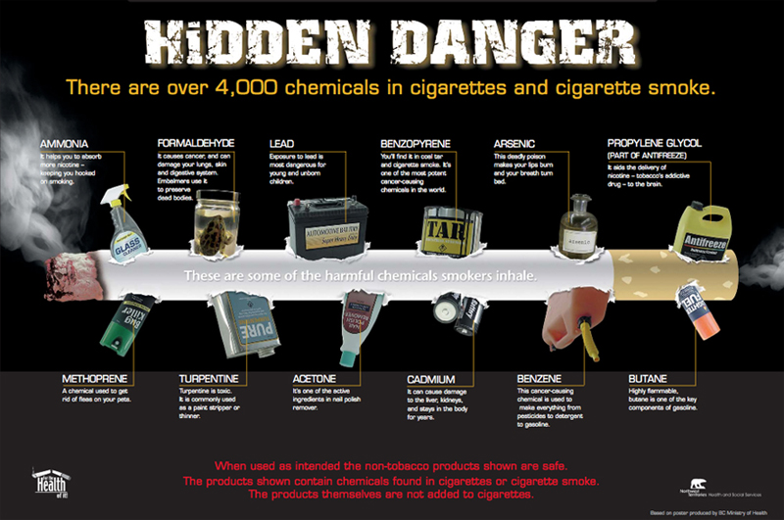
Cigarettes
Contain over 7,000 chemicals in a puff of smoke (CDC.gov 2011)!!!!!!
Include carcinogens - cancer causing agents
Tar- is the main cancer causing agent in tobacco.
Also has arsenic, butane, and acetone

Slide 4
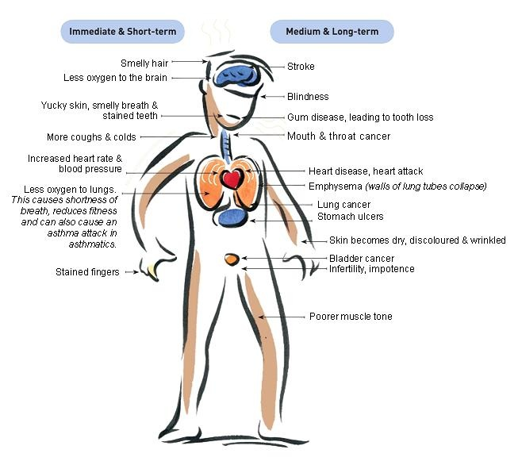
Short Term Effects of Smoking on Body
Mouth -- bad breath, yellow teeth
Senses – dulls the ability to smell & taste normally*
Lungs – reduces lung capacity; efficiency of lungs decrease.
Reduces stamina*
Shortness of breath
Fingers -- yellow stains and fingers smell.
Wrinkles skin

Slide 5
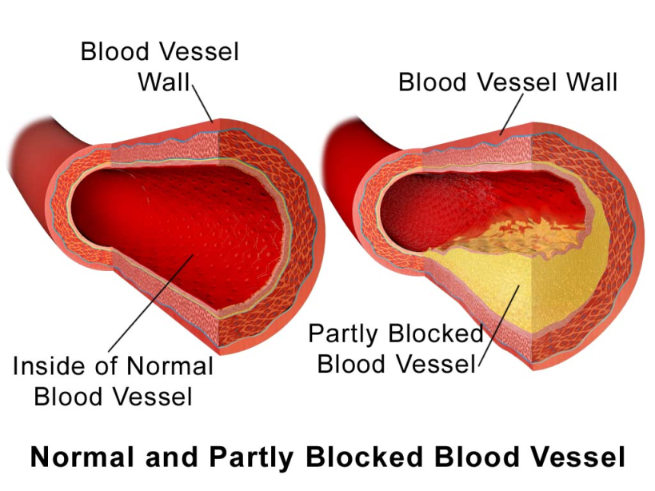
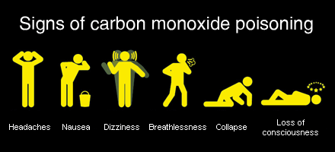
Effects (cont.)
Cardiovascular -- Nicotine causes blood vessels to constrict, forcing the heart to pump faster and increase blood pressure. Greater chance of stroke and cardiovascular disease.
WARNING- This is really gross
Carbon Monoxide -- poisonous gas when tobacco burns that cause oxygen transportation to be less efficient.

Slide 6
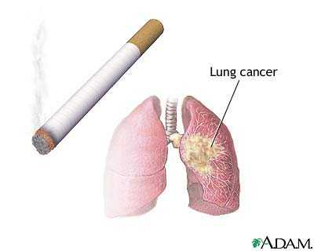
Leading causes of death from Cigarettes
Cancer
#1 cause of lung cancer
Accounts for 80% of all lung cancer deaths.
Heart disease
Smoking accounts for 1/3 of all deaths.
Heart disease is the United States #1 killer.
Smoker's lung Vine

Slide 7
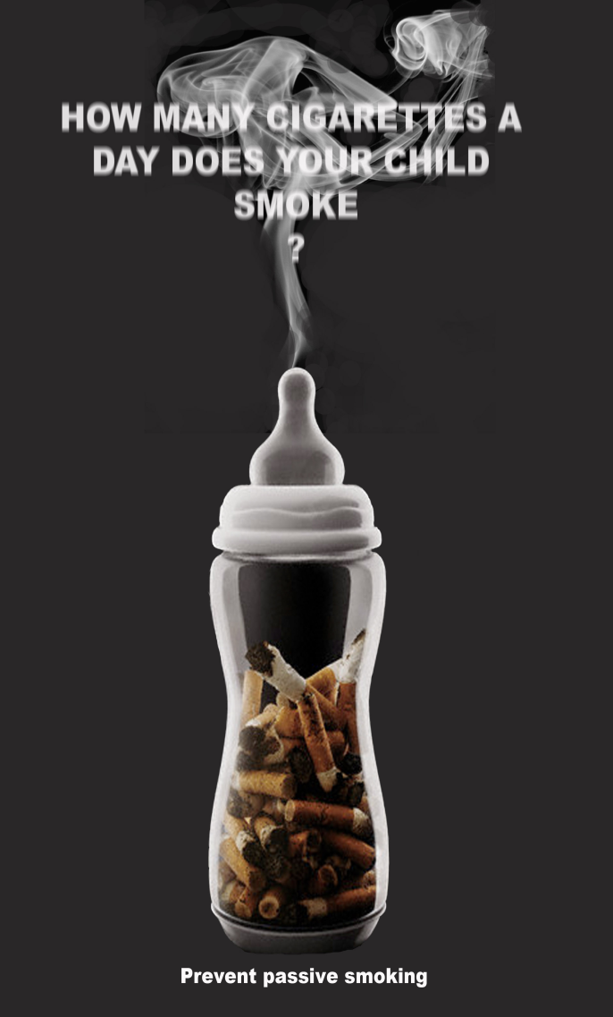
Passive Smoking
Mainstream -- The smoke that is exhaled by the smoker.
Sidestream Smoke -- smoke that enters the air from the burning tip of the cigarette. (Worst kind)
“Second hand” Smoke--made up of side stream smoke and exhaled mainstream smoke, mixed with the surrounding air.
"Third-hand“ or “Passive” Smoke --cigarette byproducts that cling to smokers' hair and clothing as well as to household fabrics, carpets and surfaces — even after secondhand smoke has cleared. Involuntarily inhaling

Slide 8
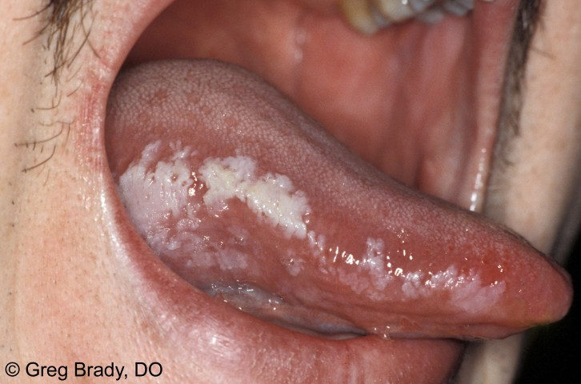
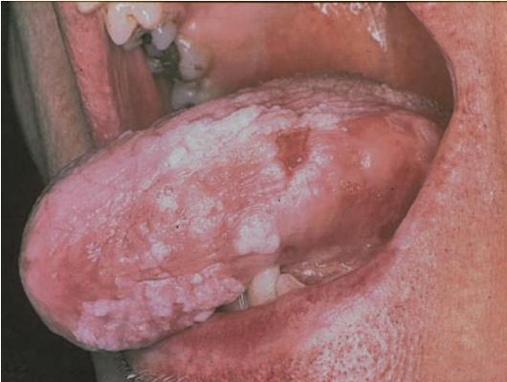
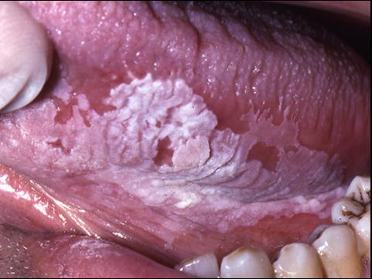
Smokeless Tobacco
What are some smokeless tobacco products?
Greater risk of mouth or lung cancer than smoking.
Leukoplakia -- thickened, white, leathery appearing spots inside mouth.
Tongue, cheeks, gums, throat
Can develop into cancer.
**On the Test!!**
WARNING- Gross pictures ahead

Slide 9
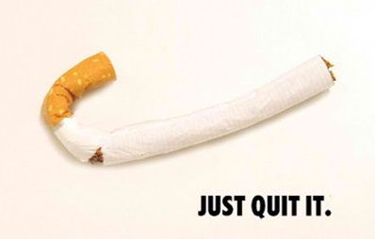
Quitting & Ways to Start
Remind yourself of the benefits
Find ways to replace tobacco
Gum, suckers, toothpicks, nicotine patches, etc.
Seek Support
SmokefreeTXT
QuitStartAPP
LiveHelpChat
Quit Smoking Timeline
It takes 10 years after quitting for a smoker’s risks of lung cancer to be the same as a non smoker
What are some of the benefits of quitting?

